Slide 1
Deep Reinforcement Learning (DRL)
Notes:
Big data is a core part of this class and it as helped drive deep learning. For those in industry, you have likely heard of a number of definitions, but to level set I’ll try to define.

Slide 2
Reinforcement Learning
A technique to allow an agent to take actions and interact with an environment to maximize the total rewards
In other words:
Reward good behavior
Punish bad behavior

Slide 3
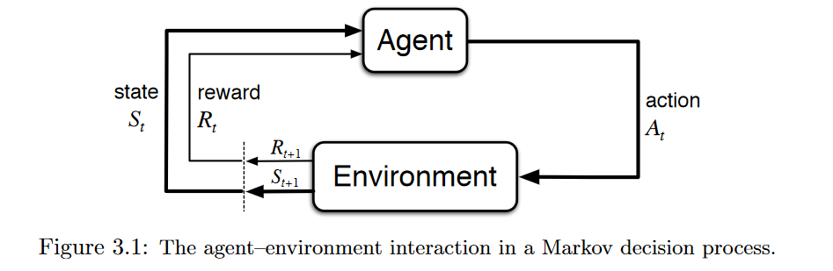
Reinforcement Learning (cont.)
The agent takes an action within the environment
A reward is issued, and a new state is returned
The agent takes another action in the new environment (generated from the state)
Source: https://towardsdatascience.com/applications-of-reinforcement-learning-in-real-world-1a94955bcd12

Slide 4
Explore vs. Exploit: Epsilon
Epsilon is used to determine whether we use the Q-function to take our next step or if we take a random step.
The chance of exploiting the model (using the Q-function) vs. exploring the action space (random step) is determined by the value of epsilon.
A typical epsilon is 5% (there is a 5% chance of taking a random action).
Epsilon decay is used to reduce the epsilon value over time.
The more we train, the more we trust the Q-function.

Slide 5
Making RL Deep: Q-Learning
Give our agent memory in the form of a Q-table.
The table is of size states by actions.
Store a value for each state-action combination.
The values estimate the reward we get from a particular action (aka Q-values).
Higher Q-values imply better chances of getting greater rewards.

Slide 6
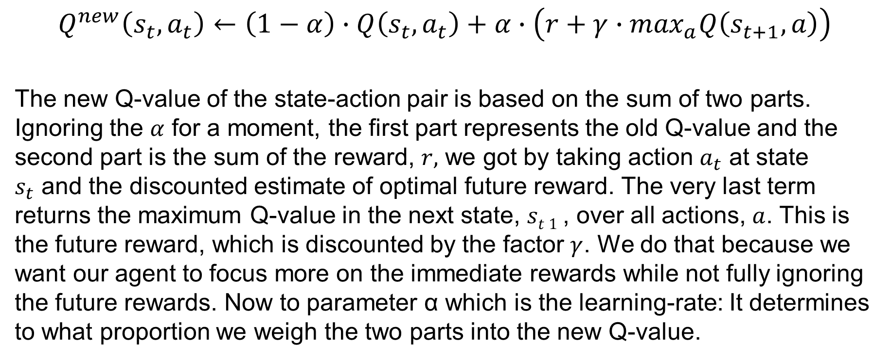
Making RL Deep: Q-Learning (cont.)
$$Q^{new}\left(s_{t},a_{t}\right)←\left(1−α\right)∙Q\left(s_{t},a_{t}\right)+α∙\left(r+γ∙\max_{a}Q\left(s_{t+1},a\right)\right)$$
The new Q-value of the state-action pair is based on the sum of two parts. Ignoring the $α$ for a moment, the first part represents the old Q-value and the second part is the sum of the reward, $r,$ we got by taking action $a_{t}$ at state $s_{t}$ and the discounted estimate of optimal future reward. The very last term returns the maximum Q-value in the next state, $st 1$, over all actions, $a$. This is the future reward, which is discounted by the factor $γ$. We do that because we want our agent to focus more on the immediate rewards while not fully ignoring the future rewards. Now to parameter α which is the learning-rate: It determines to what proportion we weigh the two parts into the new Q-value.
Source: https://www.novatec-gmbh.de/en/blog/introduction-to-q-learning/

Slide 7
Q-Learning Illustrated, Part I
We can go left one square or right one square.
State “Left 1”
State “Right 1”
“Left”
“Right”
Network
Initial state

Slide 8
Q-Learning Illustrated, Part II
If we go left, then the following step has a max value of 27.
Evaluate
State “Left 1”
State “Right 1”
Max is 27!
“Left”
“Right”
Left:
Q* = 27
Right:
Q* = 4
Network
Network
Evaluate
Initial state
State
“Left 1”

Slide 9
Q-Learning Illustrated, Part III
We assign a value of 27 to the left choice.
Evaluate
State “Left 1”
State “Right 1”
Max is 27!
Update
“Left”
“Right”
Left:
Q* = 27
Right:
Q* = 4
27
“Right”
Network
Network
Network
Evaluate
Go back
Initial state
State
“Left 1”
Initial state

Slide 10
Q-Learning Repeated
If we go right, then the following step has a max value of 14.
Evaluate
State “Right 1”
Max is 14!
Update
27
“Right”
Left:
Q* = 14
Right:
Q* = 2
27
14
Network
Network
Network
Evaluate
Go back
Initial state
State “Right 1”
Initial state

Slide 11
Q-Learning First Training Sample
Our Q-table now shows our inputs (state) and outputs (action, reward pairs), so …
We have our first training sample for our network!
Results will essentially be totally random at first, but network will improve with time!
27
14
Network
Initial state

Slide 12
Q-Learning First Training Sample (cont.)
At runtime it is easy to decide on an action!
But note that for training, we could feed any state into the network—it doesn’t have to be a sequential process, and it doesn’t really matter what action we choose to generate our next sample. This is what makes Q-learning an “off-policy” method!
This is nice for parallelizing and for exploration/“what-if” scenarios!
Left:
27
Right:
14
Go left!
State 2
Network
Initial state

Slide 13
What Is a Platform?
A virtual world
Provides rules and physics
Gravity
Walls
Hills
Cheaper and faster than real world

Slide 14
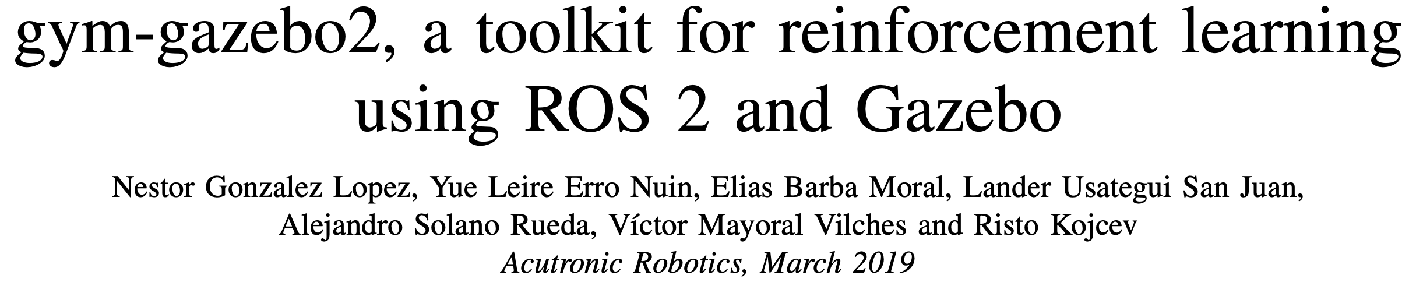
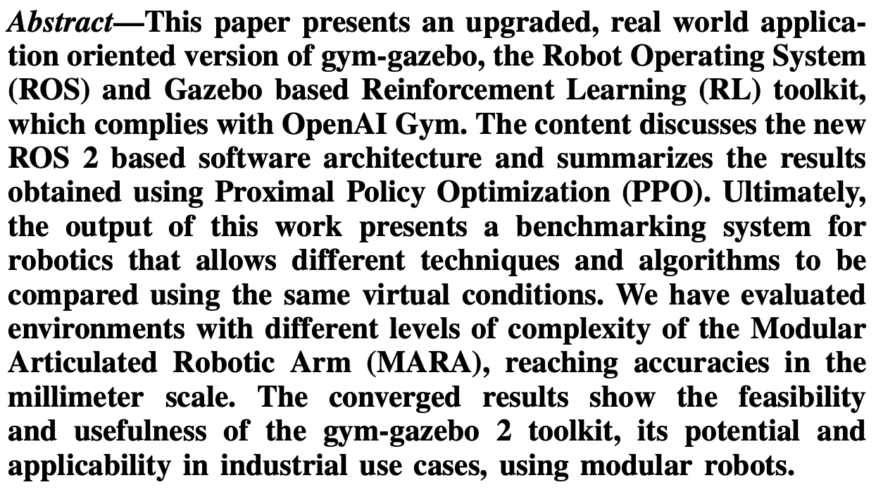
Gazebo
Robot simulation environment
Build your own robot
https://arxiv.org/pdf/1903.06278.pdf

Slide 15
OpenAI
Multi-agent environments (hide and seek)
Gym Retro (based on retro games)

Slide 16
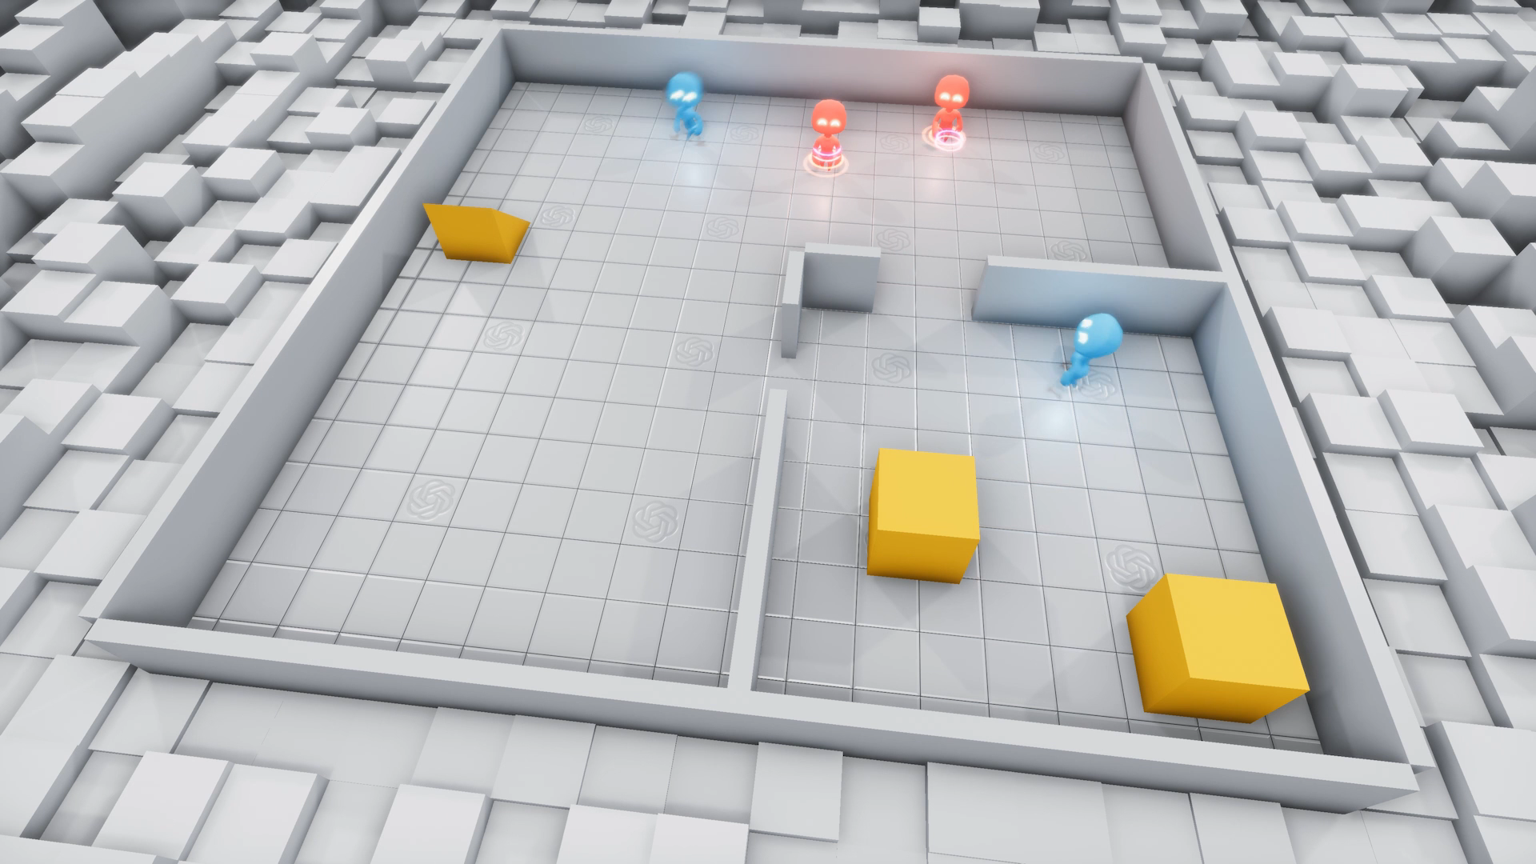
Multi-Agent
Multiple agents interacting with each other and their environment
https://openai.com/blog/emergent-tool-use/
Notes:
Ramp Defense was learned after 43.4 MILLION episodes

Slide 17
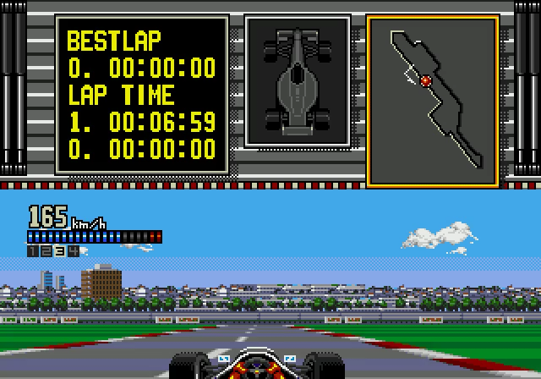
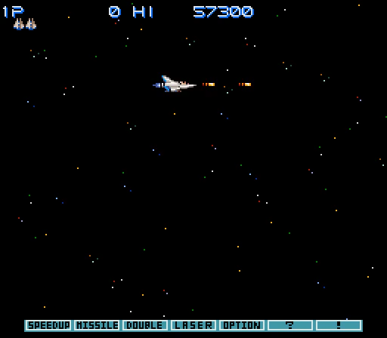
Gym Retro
Includes games from the Sega Genesis and Sega Master System and Nintendo’s NES, SNES, and Game Boy consoles; it also includes preliminary support for the Sega Game Gear, Nintendo Game Boy Color, Nintendo Game Boy Advance, and NEC TurboGrafx
https://github.com/openai/retro

Slide 18
Custom Platforms
Google
AWS DeepRacer
Unreal Engine

